Slide 1
Earth’s Structure

Slide 2

By the end of this lesson, you should be able to:
Describe the scientific field of geology.
Describe the four compositional layers of the Earth.
Compare and contrast these layers based on compositional features.
Explain the scientific evidence that supports the theory of the Earth’s structure.

Slide 3
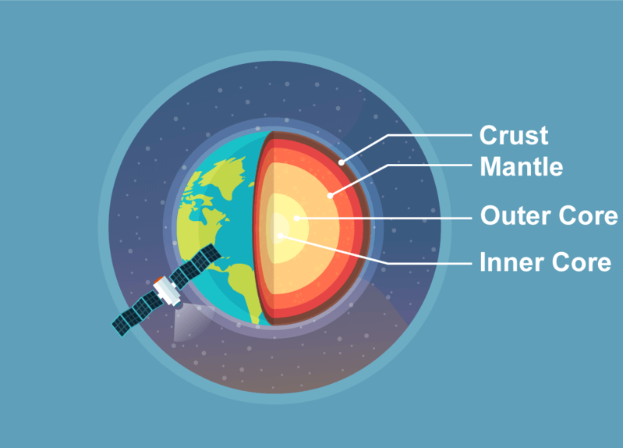
The structure of the Earth is divided into four major components.
These components are the crust, the mantle, the outer core and the inner core.
Each layer has a unique chemical composition and physical state, and can impact life on the Earth’s surface.
As a result of their unique chemical and physical compositions, these four main components of the Earth are also called the “compositional layers” of the Earth.
Let’s examine the first compositional layer of the Earth, and the one we are all familiar with; the crust!

Slide 4
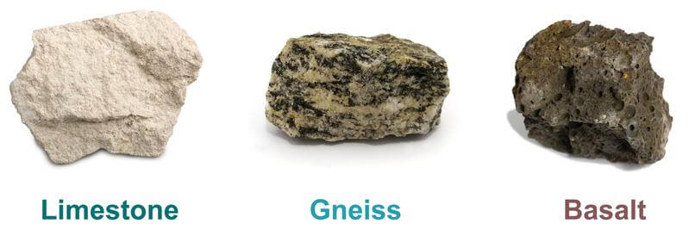
Earth’s outer surface is its crust, and it is made up of different types of rocks!
This is the compositional layer we all live on (the “terrestrial” layer). The crust is very thin, relative to the radius of Earth. It is not the same thickness all over.
The seabed is, on average, 8 kilometres (km) thick and the continents are, on average, 40 km thick. The Earth’s radius is 6 371 km, so the Earth’s crust is really thin in comparison!
The crust contains mostly low-density rocks compared to materials in the deeper compositional layers. Some of the most common rocks found in the Earth’s crust include limestone, gneiss [pronounced "nice"] and basalt.

Slide 5
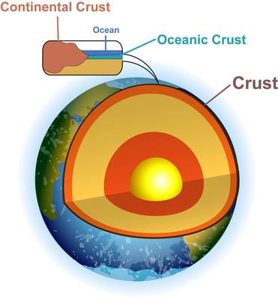
There are two very different types of crust; the continental crust and the oceanic crust.
The continental crust is up to 200 km thick (40 km on average) and as the name suggests, lies beneath the world’s continents. This crust contains lots of light granite, a felsic intrusive igneous rock. This means it forms when quartz-rich magma cools deep underground.

Slide 6
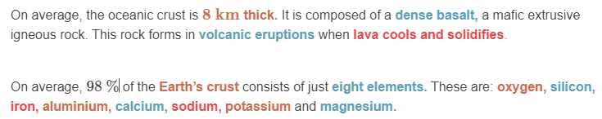
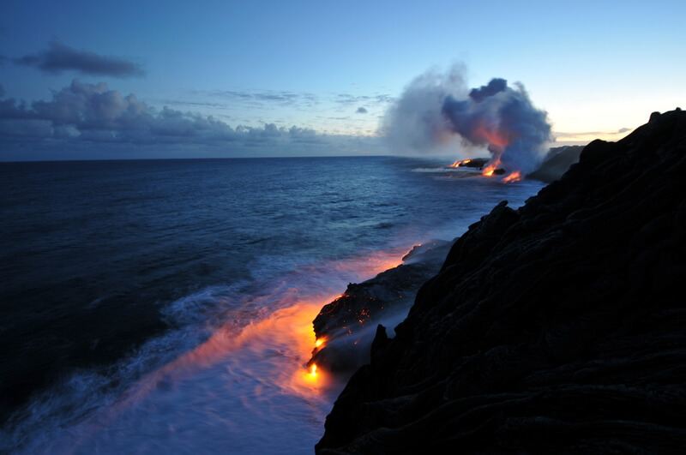
Oceanic crust is relatively thin and supports the oceans.

Slide 7
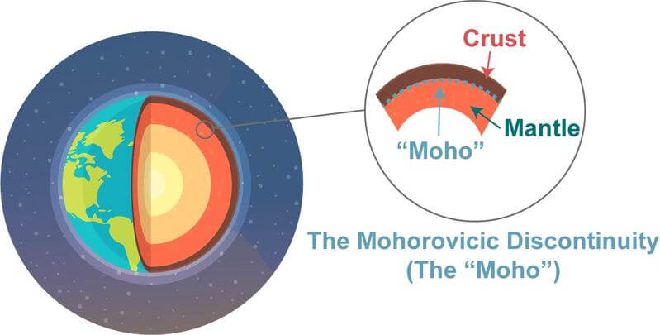
Directly below the crust is the mantle.
At 2900 km thick on average, the mantle is the thickest compositional layer of the Earth!
The mantle consists of dense rocks that contain green minerals such as olivine and bridgmanite.
In general, there are discontinuities between where the different compositional layers of the Earth start and stop.
These discontinuities have special names. For instance, between the crust and the mantle is the Mohorovicic discontinuity, commonly referred to as the “Moho”.

Slide 8
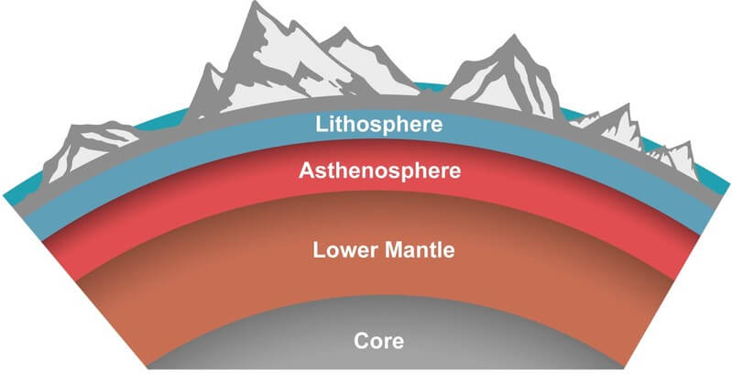
Earth’s mantle is divided into two main layers; the upper and lower mantle.
The upper mantle extends from the crust to a depth of about 410 to 660 km and is mostly solid.
Two parts of the upper mantle are recognized as distinct regions in the Earth’s interior: the lithosphere and the asthenosphere.
The lithosphere is the solid, outer part of the Earth. It includes both the crust and brittle upper portion of the mantle. Tectonic activity occurs in the lithosphere.

Slide 9
The asthenosphere in the upper mantle is the denser, weaker layer beneath the lithospheric mantle.
Temperature increases with depth in the Earth’s interior, so the upper mantle layer is cooler (1 000°C) and its rocks are less plastic.
The temperature and pressure of the asthenosphere is so high (3 700°C) that rocks soften and partly melt, becoming semi-molten.
The lower mantle layer, which is separate from the asthenosphere, extends from about 660 to 2 900 km and is much less ductile than the upper mantle.

Slide 10
The Earth’s core is the very hot, very dense centre of our planet.
The ball-shaped core lies beneath the cool, brittle crust and the mostly-solid mantle.
The core is found about 2 900 km below the Earth’s surface and has a radius of about 3 485 km.
The Earth’s core exists in two layers; the outer and inner core.

Slide 11
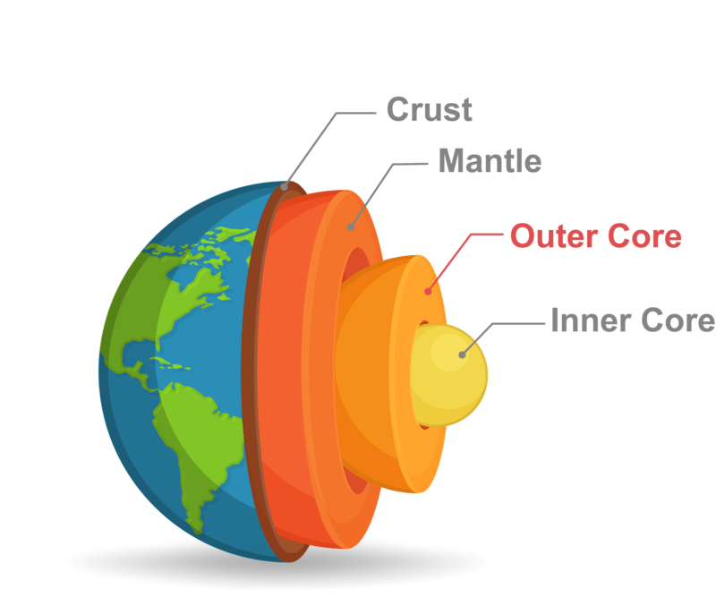
Unlike the compositional layers above it, the Earth’s core is theorized to be composed mainly of an iron and nickel alloy.
The outer core is about 2 200 km thick and is mostly composed of liquid iron and nickel.
This liquid metal of the outer core has very low viscosity, meaning it is easily deformed and malleable.
The Earth’s magnetic field is a result of convection currents in this outer iron core.

Slide 12
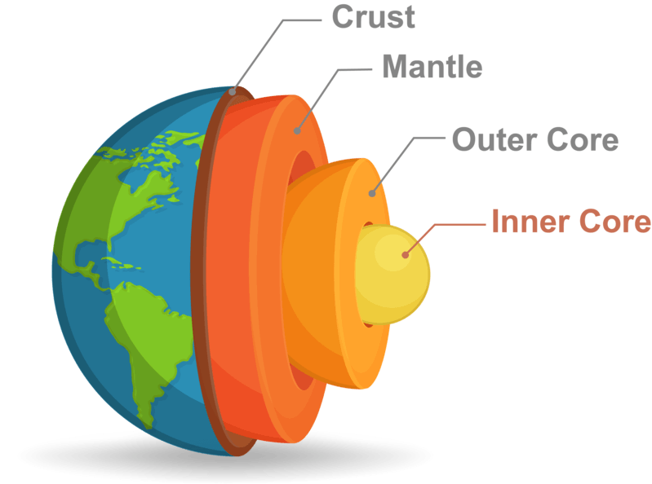
The inner core is a hot, dense ball of iron, nickel and other heavy metals.
It has a radius of around 1 220 km, a temperature of around (5 200°C) and a pressure of nearly 3.6 million atmosphere (atm)! 1 atm is atmospheric pressure at sea level.
The temperature of the inner core is far above the melting point of iron.
However, the inner core’s intense pressure prevents this iron from melting. Therefore, unlike the outer core, the inner core’s iron is considered solid.

Slide 13
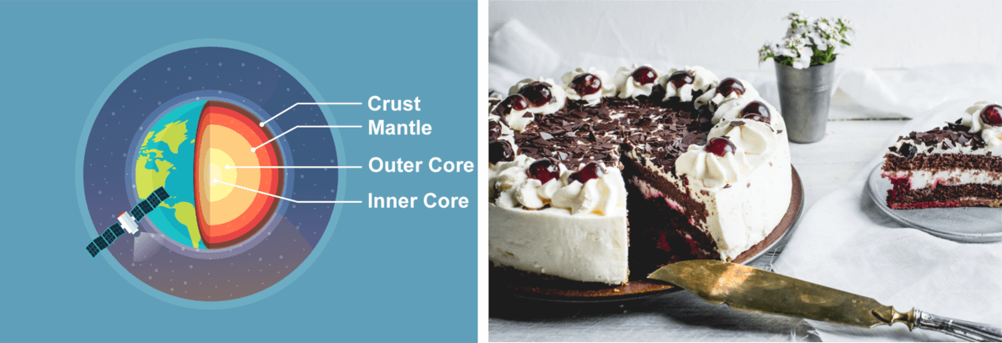
The four main compositional layers of the Earth are: the crust, the mantle, the outer core and the inner core.
Remember the Earth consists of many layers, each with a distinct composition.
You can think of the different compositional layers of the Earth like the alternating layers of cake, icing and cream in a yummy cake!

Slide 14
